Slide 1
BRASS Scenario 3
Sensor Failure
Structural Strain Test
From a flight test that occurred in February 1977

Slide 2
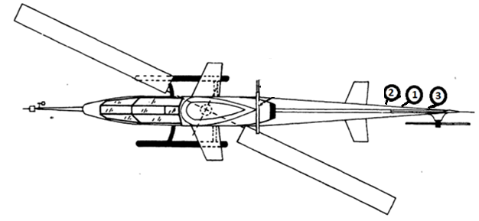
Scenario #3 – Brief Description
The objectives of the tests are to measure the strain on the tail boom of the AH-1G Helicopter.
The tests were conducted at Edwards Air Force Base, California.
Three sensors are mounted at the positions shown in the picture. During flight test, the sensor mounted in position 3 failed.
We assume that we are using the same scenario with modern and network based instrumentation.

Slide 3
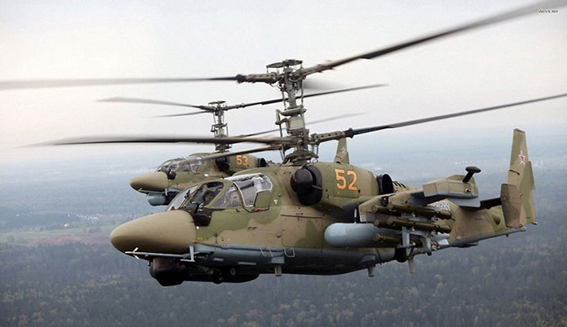
Test Article
Aircraft: AH-1G Helicopter also referred to as HueyCobra or Snake
Historical backbone of the US Army’s Attack helicopter fleet
Since upgraded versions continue to fly with the militaries of several other nations, testing programs continue to this day

Slide 4
Range Infrastructure
Range Network: Edwards Air Force Base, California
Equipment Used:
Ground Station Tracking Antenna and related network infrastructure
MCR processing live data
Equipment Available:
All in use

Slide 5
Flight Test Operation Flow

Slide 6
Associated Constraints
The sample rates are tiered at powers of 2
Adding a fourth sensor would not have changed the sample rate; however the installation cost was high enough that the additional sensor data was not worth the tradeoff

Slide 7
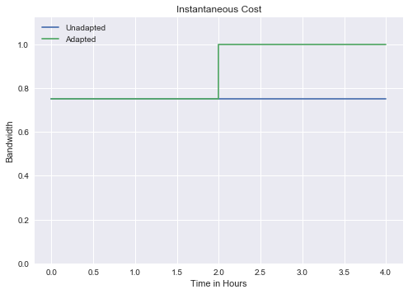
Cost Metric: Bandwidth versus Time Instantaneous Cost
Adding more inputs decreases the samples per input at powers of 2
factor = ceil(log₂n)
cost = 1/2^{factor} * n

Slide 8
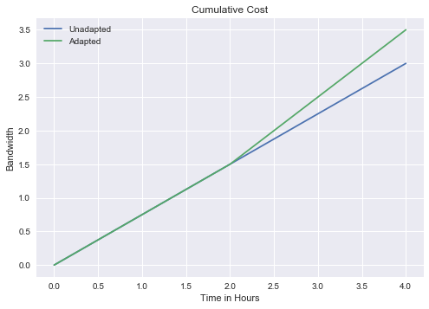
Cost Metric: Bandwidth versus Time Cumulative Cost

Slide 9
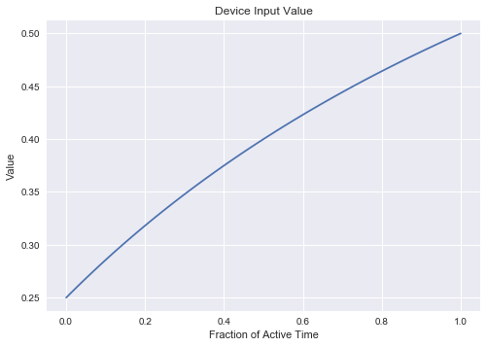
Program Value Function Device Input Value
Value of an individual input
3 sensors at ¼ time is full value
Only meaningful at non-zero sample rates
Y = 1 – 3/(2x + 4)

Slide 10
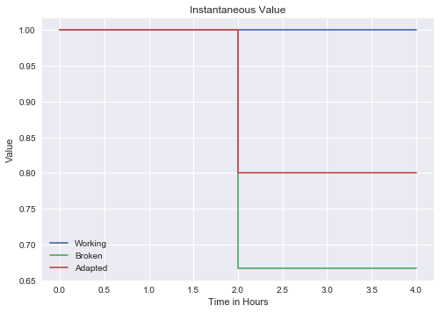
Program Value Function Instantaneous Value
Device sample rate increases as number of inputs decreases
Individual input value goes up with higher sample rates
Working – 3 inputs, all on
Broken – 3 inputs, 2 on
Adapted – 2 inputs, all on

Slide 11
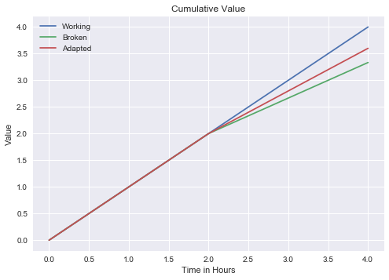
Program Value Function Cumulative Value

Slide 12
Risk Metric
Measures the future uncertainties in achieving the test mission within the defined cost and schedule constraints
Risk Probability that a particular event will occur
Level | Value | Criteria
5 | Near certainty | Everything points to this becoming a problem
4 | Very likely | High chance of this becoming a problem
3 | Likely (50/50) | There is an even chance this may turn into a problem once in a while
2 | Unlikely | Risk like this may turn into a problem once in a while
1 | Improbable | Not much chance this will become a problem

Slide 13
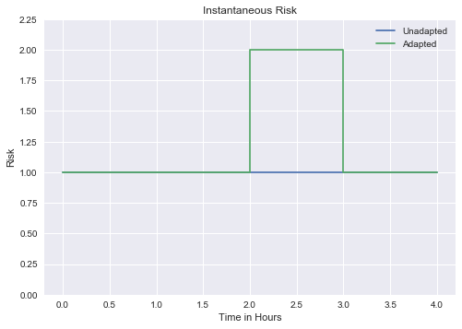
Risk Metric Instantaneous Risk
Base risk is 1
Risk during reconfiguration is 2
Device may not come back up

Slide 14
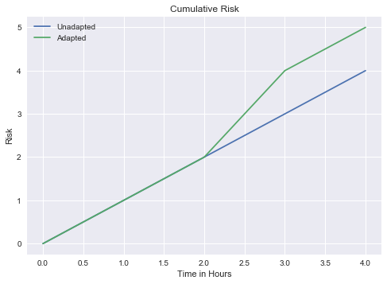
Risk Metric Cumulative Risk

Slide 15
Classic Solution
Ignore failure to avoid reconfiguring
Trades stability for increased sample rates on remaining sensors
No MDL changes needed for this solution

Slide 16
Suggested Solution
Reconfigure to drop the failed sensor data
MDL Reconfiguration
This setup describes a DAU that is composed of 3 modules, where its ports are connected to 3 different sensors
There are 3 measurements mapped to the 3 sensors
After sensor failure is identified, we need to reconfigure the DAU to only look at sensor 1 and 2

Slide 17
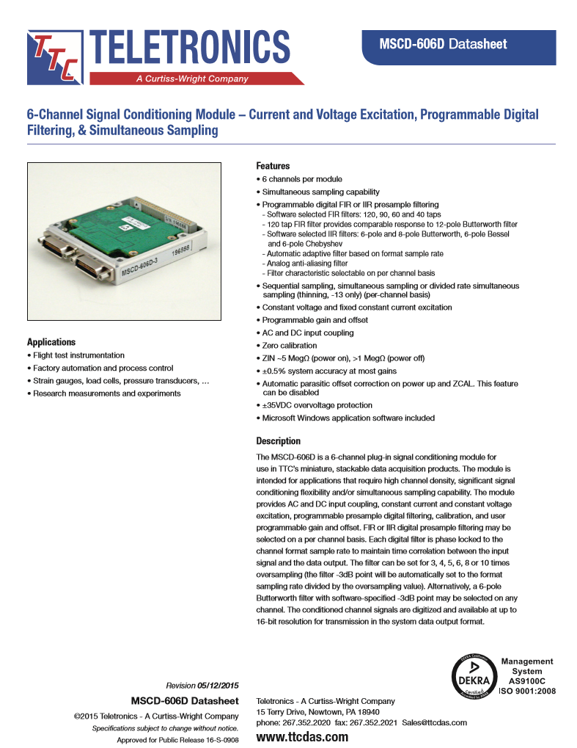
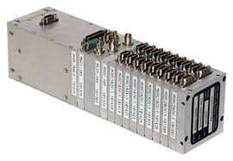
Instrumentation

Slide 18
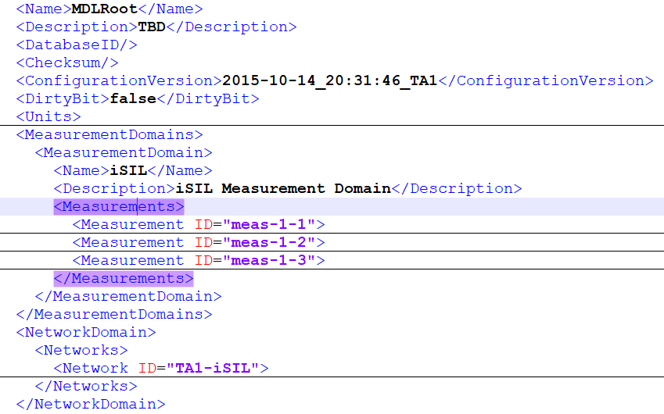
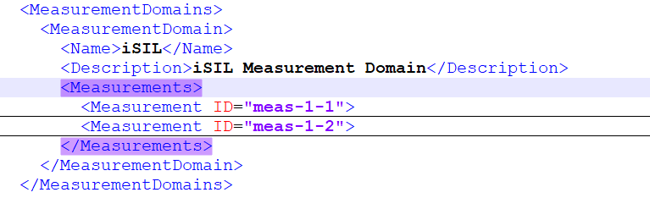
MDL Configuration - Measurements
Describes the measurement types for the configuration of the Test Article.
Before adaptation
After adaptation

Slide 19
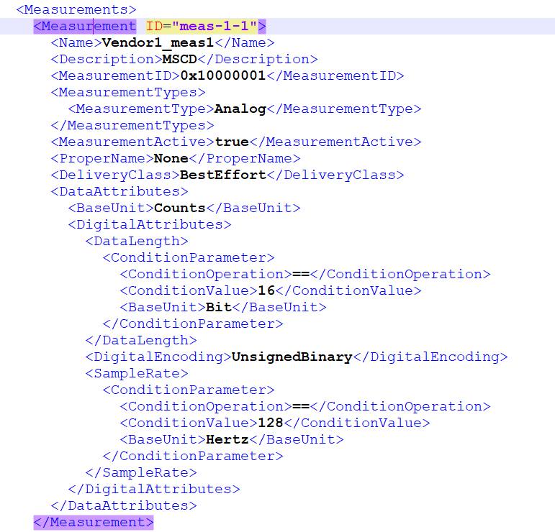
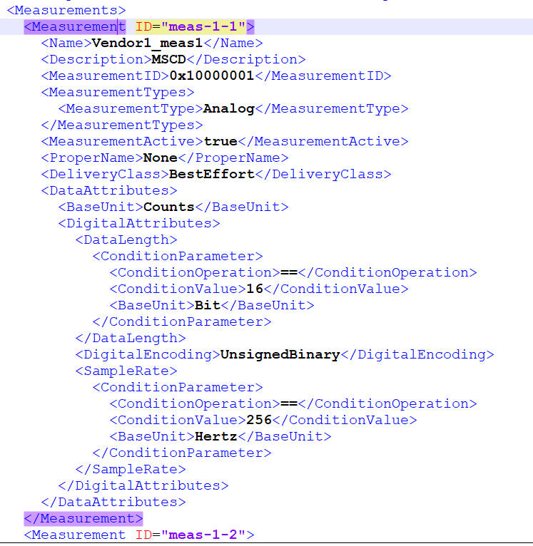
MDL Configuration – Sample Rate Description
After adaptation – Sample Rate is changed to 256 Hz
Under <DataAttributes> element, the analog attributes of the measurement are described. The sample rate is set to 128Hz before adaptation.

Slide 20
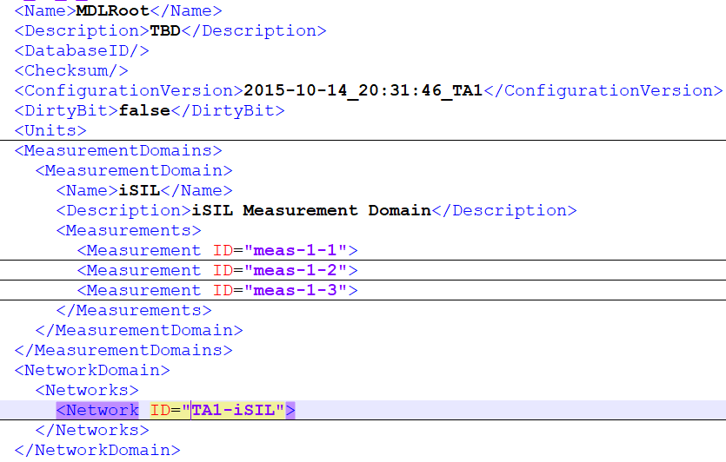
MDL – DAU Description
<Network> element describes the physical topology (how the instrumentation is interconnected), the logical configuration, performance capabilities …
This is where the DAU is described in the file.

Slide 21
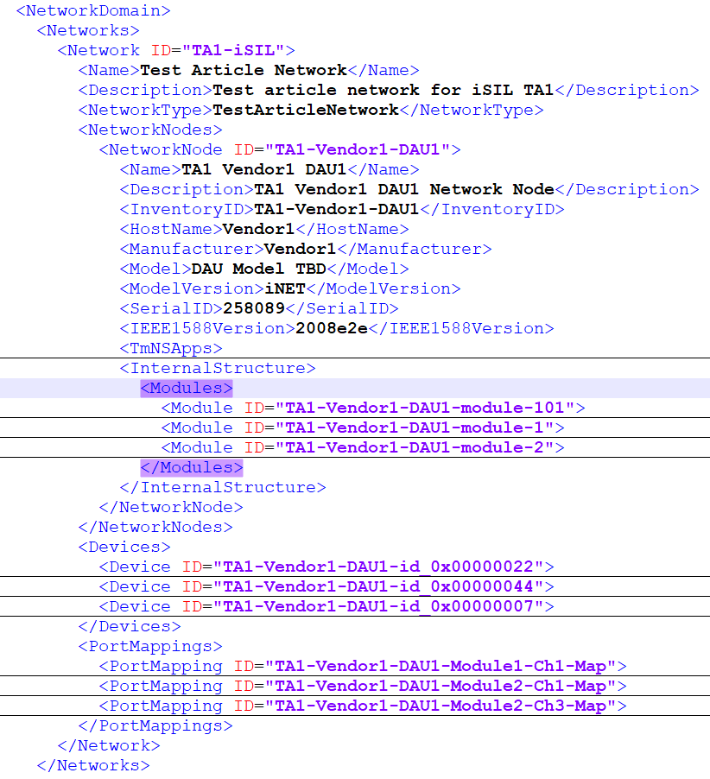
MDL – DAU Description
DAUs are generally described as a NetworkNode composed of many modules. This example contains 3 modules (CPU and 2 analog slots).
The properties of the card (or slot) is described in the <Module> element.

Slide 22
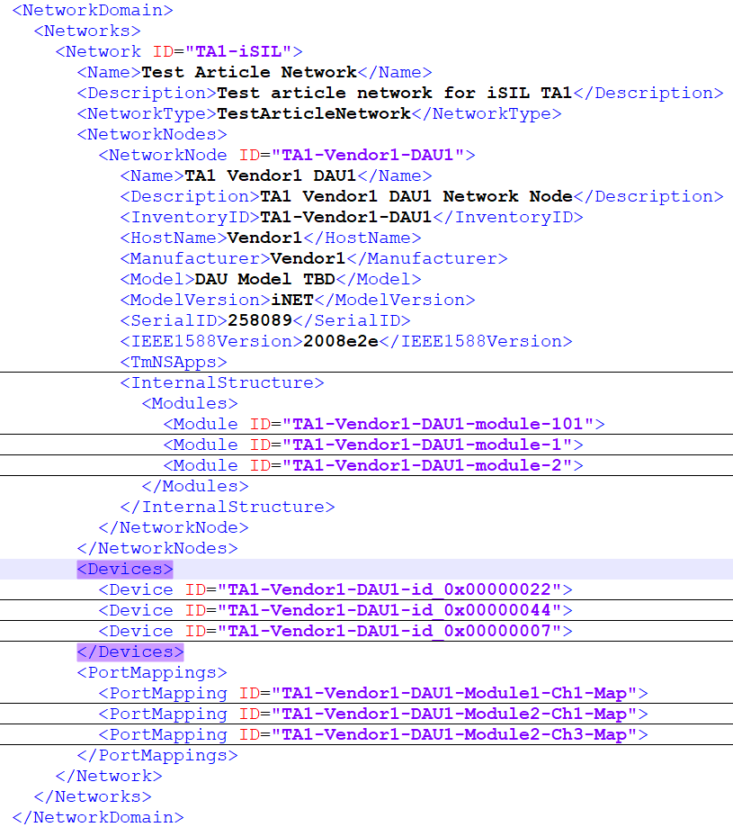
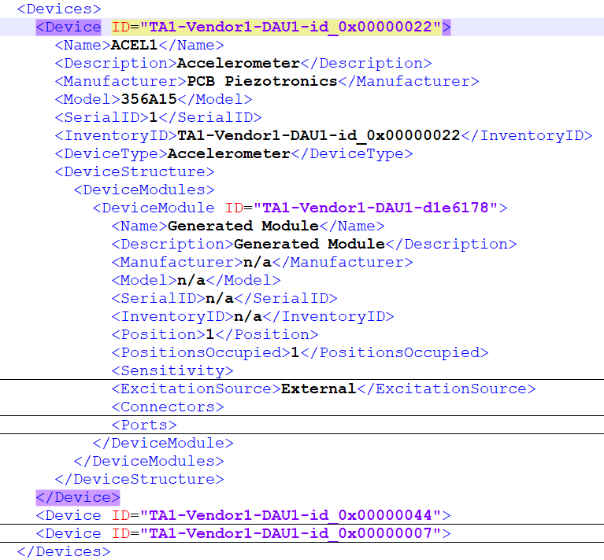
MDL – Sensors Description
<Device> describes the properties of devices such as strain gauges in our scenario.

Slide 23
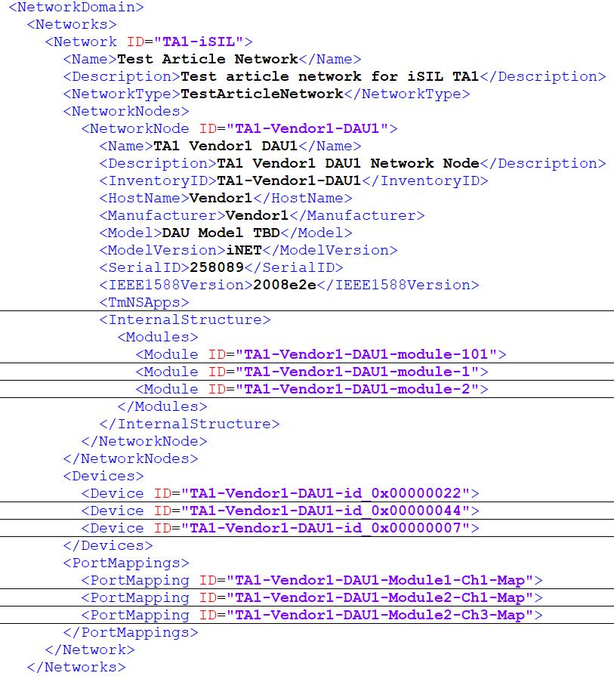

MDL – Port Description
<PortMapping> element describes the connection between two Port elements capturing the flow of data between the DAU port and sensors.
After adaptation: Removed the port mapped to the bad sensor
Before adaptation

Slide 24
sources
http://www.dtic.mil/dtic/tr/fulltext/u2/a044327.pdf

